Slide 1
State Income Tax Refund & Alimony
Pub 17, Chapters 12 & 18
(Federal 1040-Lines 10 & 11)
(NJ 1040-Line 24)
Notes:
1

Slide 2
Recoveries
Return of an amount you deducted or took a credit for in an earlier year
Most common recoveries are refunds, reimbursements, and rebates of deductions itemized on Schedule A:
State income tax refund
Property tax reimbursement (PTR) – covered in later module
Homestead Benefit – covered in later module
Others – such as medical expense reimbursement
Notes:
2

Slide 3
Recoveries
(cont’d)
Tax benefit rule
Must include a recovery in your income in the year you receive it up to the amount by which the deduction/credit you took for the recovered amount reduced your tax in earlier year
Use State Refund Worksheet to determine how much of recovery has to be claimed in current year
Notes:
If you a were eligible to claim a deduction/credit, but didn’t actually take it or all of it…then you don’t have a recovery. Only recover up to the amount of what you took.
3

Slide 4
NJ Income Tax Refund May Be Taxable
NJ income tax refund received in current year relating to taxes paid in an earlier year
Can get info on NJ income tax refund from NJ Division of Taxation website Refund Lookup Tool
Link from TaxPrep4Free.org Preparer page to NJ Form 1099-G Inquiry
Need SS #, Date of Birth, Name, & Zip Code
Amount from previous year tax return must be verified since amount could have changed (error found, return amended, etc.)
Notes:
4

Slide 5
NJ Income Tax Refund May Be Taxable
(cont’d)
Determine if there was a tax benefit in earlier year from NJ income tax paid
No tax benefit in earlier year if:
Taxpayer did not itemize (used Standard Deduction) OR
Elected to deduct State & Local sales tax (Sch A Line 5b) instead of State & Local Income tax (Line 5a)
If no tax benefit in earlier year, don’t declare refund in current year
Notes:
5

Slide 6
NJ Income Tax Refund May Be Taxable
(cont’d)
Possible tax benefit in earlier year if:
Taxpayer itemized (Sch A) & claimed a deduction for State/Local taxes paid (Line 5a)
Refund is taxable only to the extent that:
State income tax deduction exceeds sales tax deduction *
Itemized deductions exceed standard deduction
All nonrefundable credits were used on prior year return
Use State Refund Worksheet to determine taxable amount of refund
Reported on 1040 Line 10
NJ Income Tax Refund is not taxable in NJ – TaxSlayer handles automatically
* State income tax vs. sales tax deduction comparison is not available in Practice Lab. Awaiting 2016 TaxSlayer. Use Bogart calculator on TaxPrep4Free.org or do manual calculation
Notes:
The State Refund Worksheet available in Practice Lab does not do the comparison between the state income tax deduction and the sales tax deduction. An enhancement has been requested. We are not sure if TaxSlayer will make that change. In the meantime, use the Bogart calculator on the TaxPrep4Free.org Preparer page
6

Slide 7
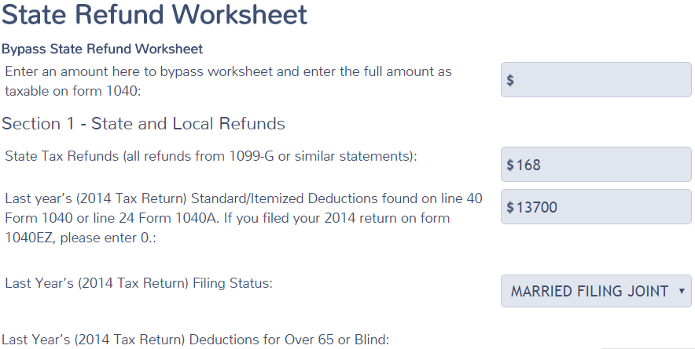
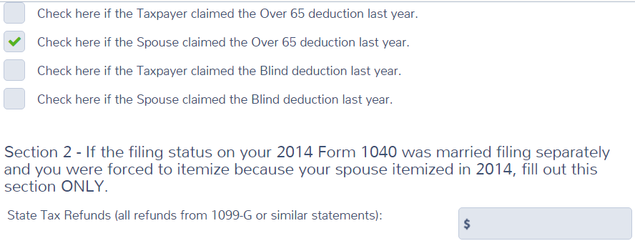
TS - State Refund Worksheet Federal Section \ Income \ Enter Myself \ State and Local Refunds (1099-G Box 2)
Amount here will make entire refund taxable
Prior year income tax refund
Info from prior year return
Notes:
This is the TS Worksheet. It does not have all the functionality it should to calculate the taxable amount of state refunds correctly. We have requested an enhancement. Awaiting to see if 2016 software includes this enhancement
7

Slide 8
State Tax Refund Worksheet – TS Tips
If you wish to bypass the State Refund Worksheet and enter full amount of last year’s refund as taxable on 1040 Line 10, enter amount from 1099-G on top line
If you wish to have TaxSlayer calculate whether the entire refund is taxable, use Section 1
Enter last year’s refund
Enter prior year standard/itemized deductions amount from 1040 Line 40
Enter prior year filing status
Check box if taxpayer/spouse claimed the over 65 or blind deduction in the prior year
Notes:
If last years taxable income 1040 line 43 is zero, (it may have actually been negative but shows as zero) you must recalculate to see if it was negative.
AGI line 38
Less line 40 itemized deductions
Less line 42 exemptions
===============
If this is a negative number, use the Bogart calculator on TaxPrep4Free.org since TS cannot handle negative taxable income
8

Slide 9
State Tax Refund Worksheet – TS Tips
(cont’d)
TS determines the taxable amount of the refund by calculating how much last year’s income tax deduction exceeded sales tax deduction. That amount is transferred to 1040 Line 10*
If taxpayer had to itemize on previous year’s return due to MFS filing status and spouse chose itemizing, use Section 2
Enter last year’s tax refund
* TaxSlayer should also compare excess of state income tax over state sales
tax when calculating taxable amount of refund. Does not do so in Practice Lab.
Awaiting 2016 TaxSlayer. In the meantime, counselor should use Bogart calculator
on TaxPrep4Free or do manual calculation if needed
Notes:
9

Slide 10
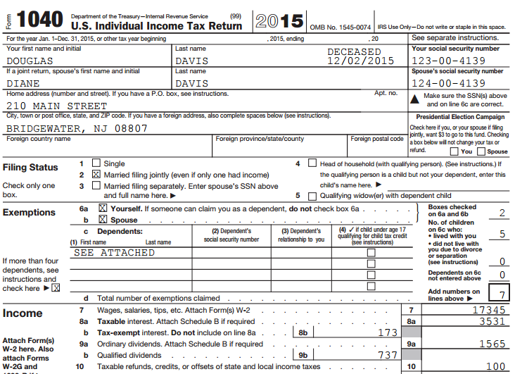
TS 1040 Line 10 – State Tax Refund
TS transfers taxable amount of prior year NJ refund from State
Refund Worksheet
Notes:
TS will transfer the taxable amount of the state income tax refund to 1040 Line 10
10

Slide 11
Alimony
Pub 4012 Tab E
Payment to or for a spouse or former spouse under a divorce or separation agreement
Deductible by the payer
Income for the receiver
The amount is as specified in the agreement – any other voluntary amounts are not income or deductible
Child support is not alimony
See Pub 4012 Tab E for alimony requirements
Notes:
Pub 4012 Page E-5 lists all the requirements for payments to be considered alimony. Examples are:
Payments must be required by a divorce or separation agreement
Payer and recipient cannot file a joint return with each other
There is no tax document for alimony. You must ask client. Last year’s return might give you a clue
Just because the court ordered Alimony, doesn’t mean that it was paid
You can claim alimony you paid as an adjustment to income on 1040 Line 31 (covered in a later module)
Legal child support is not taxable to the recipient

Slide 12
TS - Alimony Received Federal section \ Income \ Enter Myself \ Alimony Received
Pub 4012 Tab E
Alimony received is taxable
Notes:
12

